Slide 1
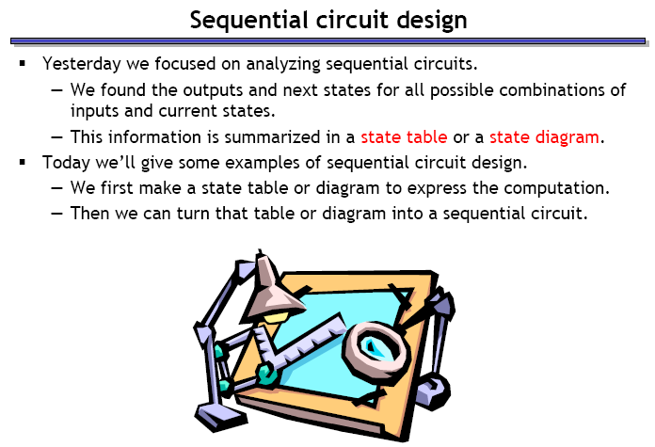
DESIGN OF CLOCKED SEQUENTIAL CIRCUITS

Slide 2
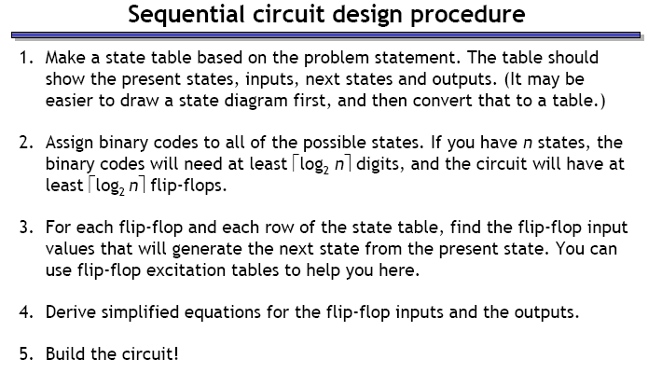

Slide 3
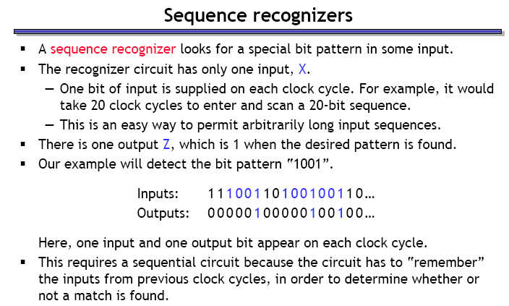

Slide 4
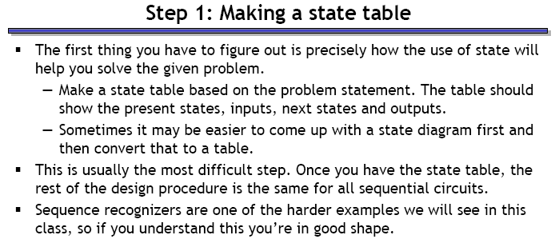

Slide 5
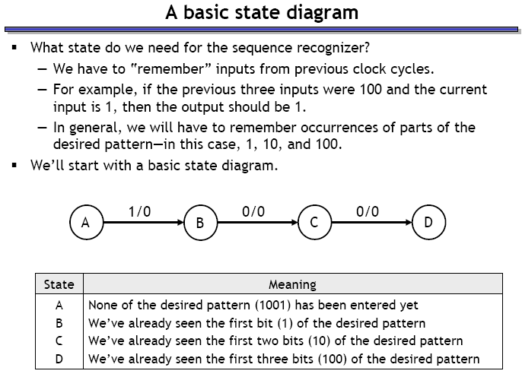

Slide 6
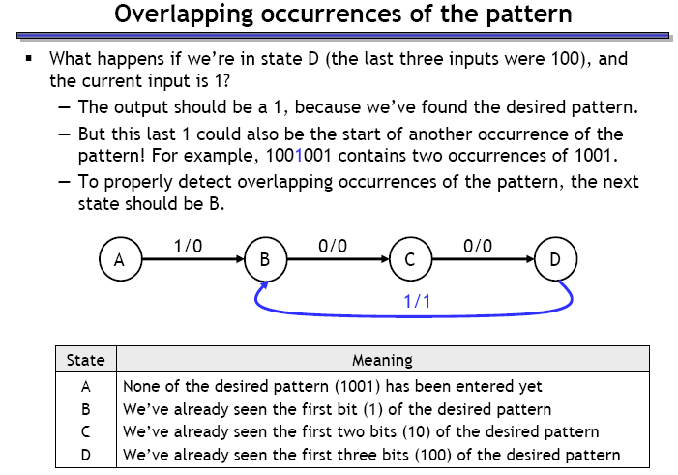

Slide 7
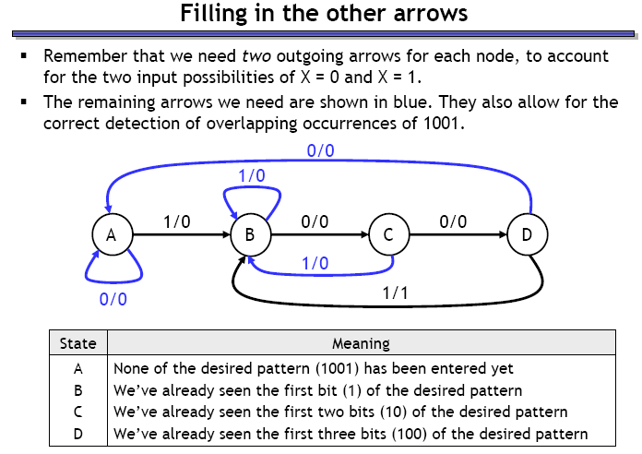

Slide 8
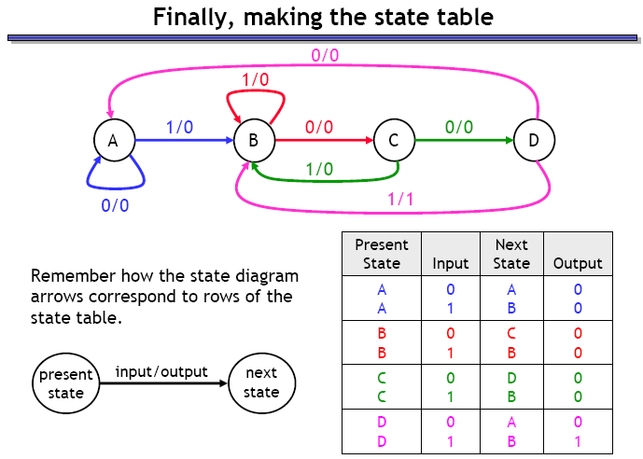

Slide 9
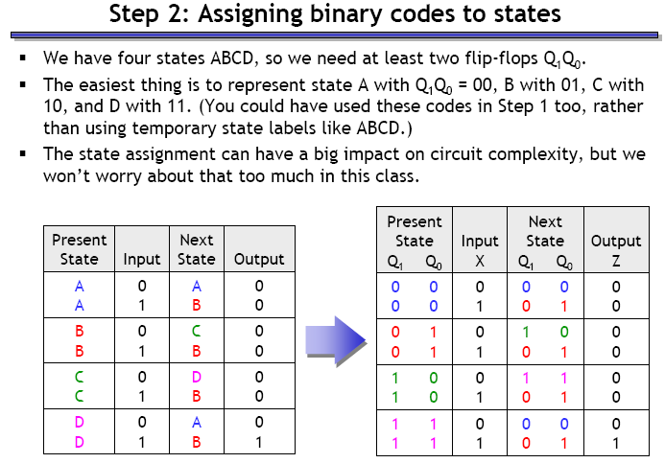

Slide 10
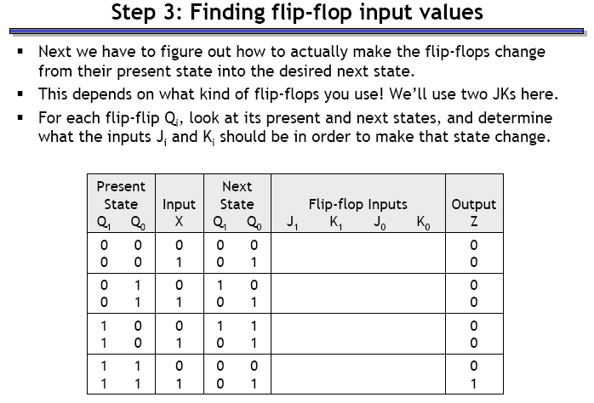

Slide 11
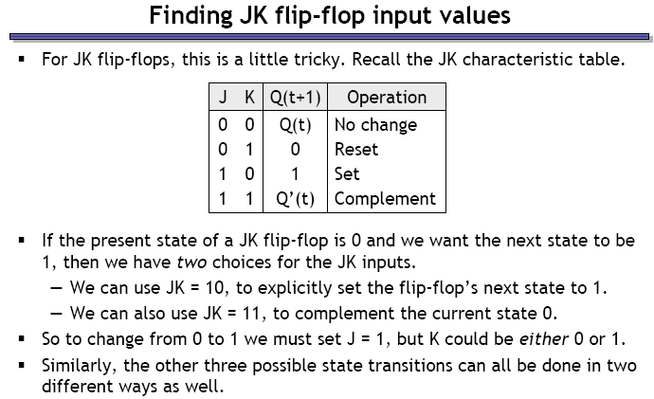

Slide 12
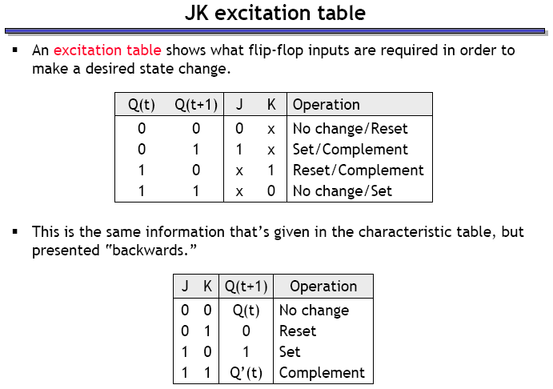

Slide 13
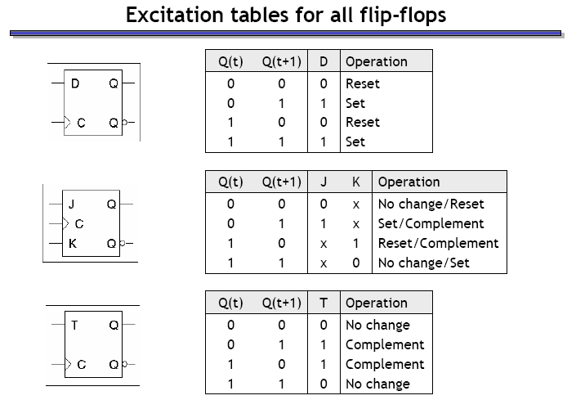

Slide 14
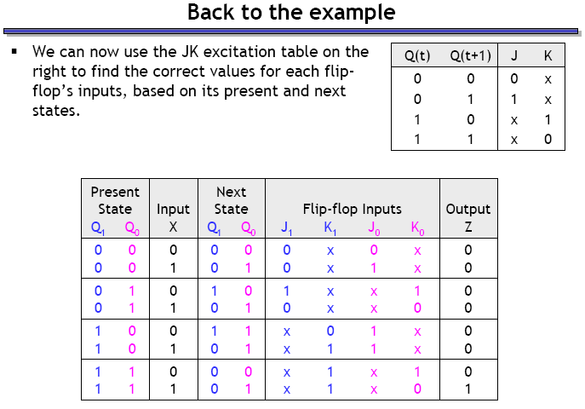

Slide 15
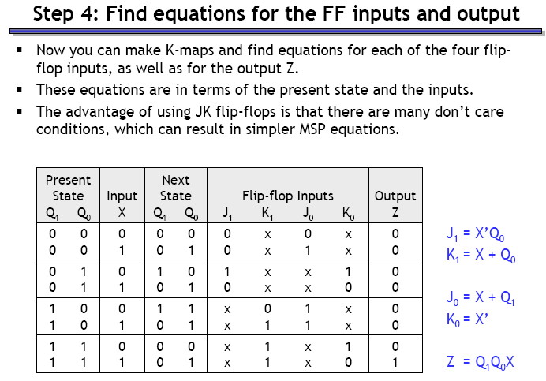

Slide 16
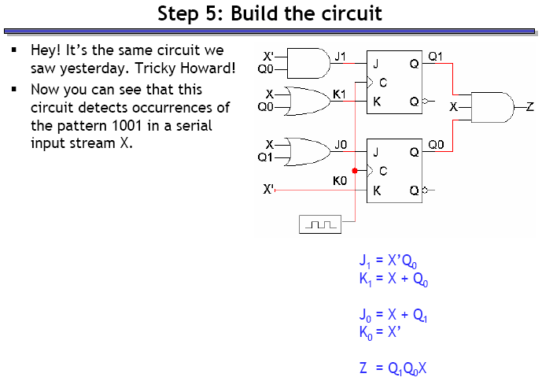

Slide 17
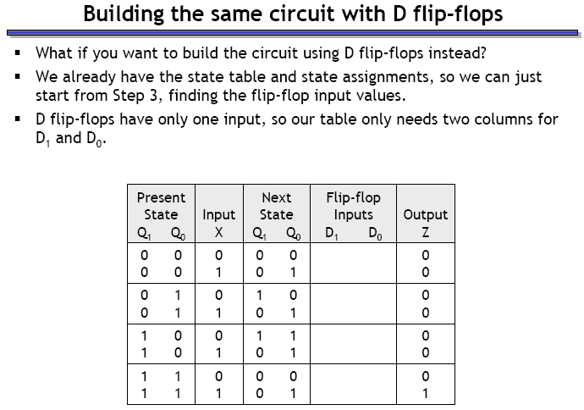

Slide 18
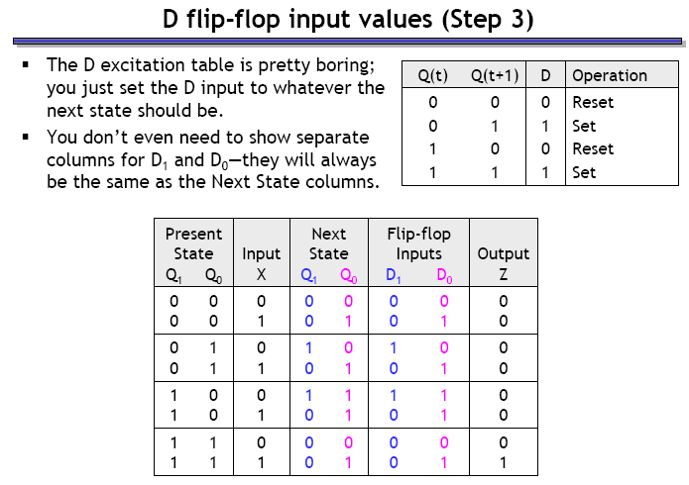

Slide 19
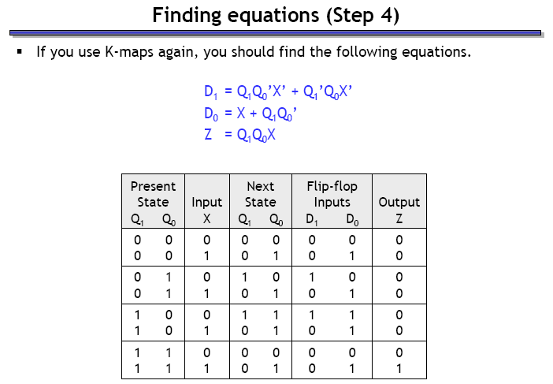

Slide 20
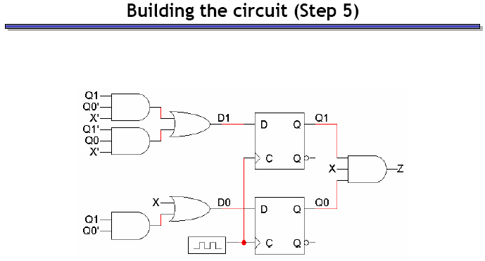

Slide 21
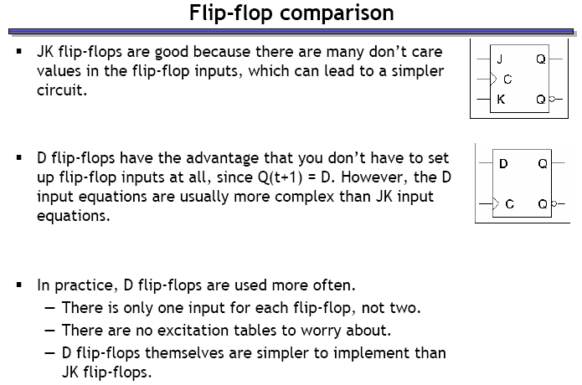

Slide 22
DESIGN WITH UNUSED STATES

Slide 23
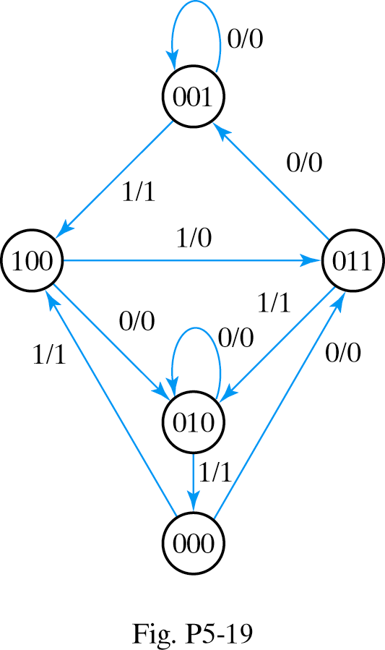

Design the circuit using D Flip Flops

Slide 24
Answer:
D_{a}=A’B’x
D_{b}=C’x’+A+BCx
D_{c}=A’B’x’+Cx’+Ax
Y=A’x
The circuit is self correcting

Slide 25
STATE REDUCTION

Slide 26
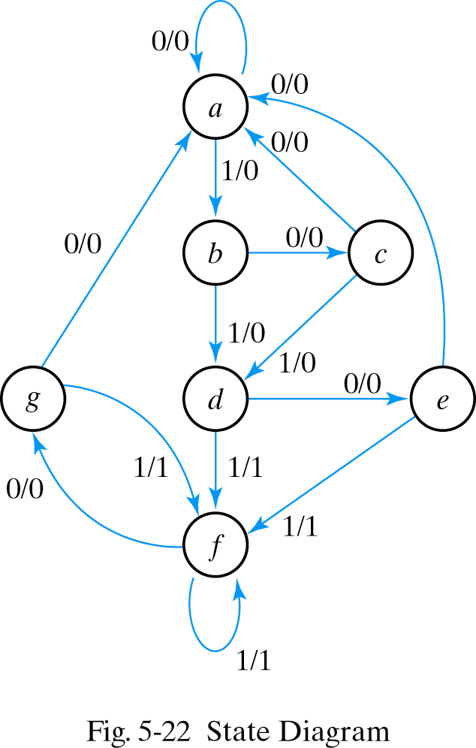

Slide 27
STATE TABLE
Present state | Next State |  | Output
 | X=0 | X=1 | X=0 | X=1
a | a | b | 0 | 0
b | c | d | 0 | 0
c | a | d | 0 | 0
d | e | f | 0 | 1
e | a | f | 0 | 1
f | g | f | 0 | 1
g | a | f | 0 | 1

Slide 28
STATE TABLE
Present state | Next State |  | Output
 | X=0 | X=1 | X=0 | X=1
a | a | b | 0 | 0
b | c | d | 0 | 0
c | a | d | 0 | 0
d | e | f | 0 | 1
e | a | f | 0 | 1
f | g e | f | 0 | 1
g | a | f | 0 | 1

Slide 29
STATE TABLE
Present state | Next State |  | Output
 | X=0 | X=1 | X=0 | X=1
a | a | b | 0 | 0
b | c | d | 0 | 0
c | a | d | 0 | 0
d | e | f | 0 | 1
e | a | f | 0 | 1
f | e | f | 0 | 1

Slide 30
STATE TABLE
Present state | Next State |  | Output
 | X=0 | X=1 | X=0 | X=1
a | a | b | 0 | 0
b | c | d | 0 | 0
c | a | d | 0 | 0
d | e | f d | 0 | 1
e | a | f d | 0 | 1
f | e | f | 0 | 1

Slide 31
STATE TABLE
Present state | Next State |  | Output
 | X=0 | X=1 | X=0 | X=1
a | a | b | 0 | 0
b | c | d | 0 | 0
c | a | d | 0 | 0
d | e | d | 0 | 1
e | a | d | 0 | 1

Slide 32
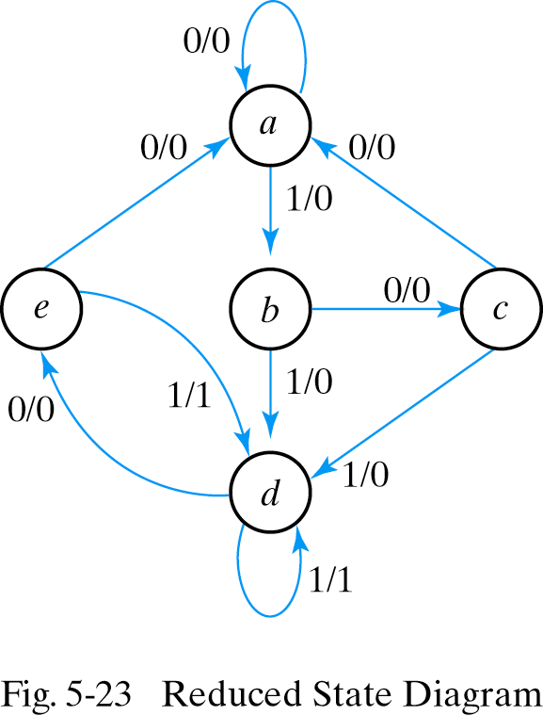

Slide 33
